Slide 1
Site Map
Homepage
Grooming Services
Map to Shop
Contact Us
Selecting a Pet

Slide 2



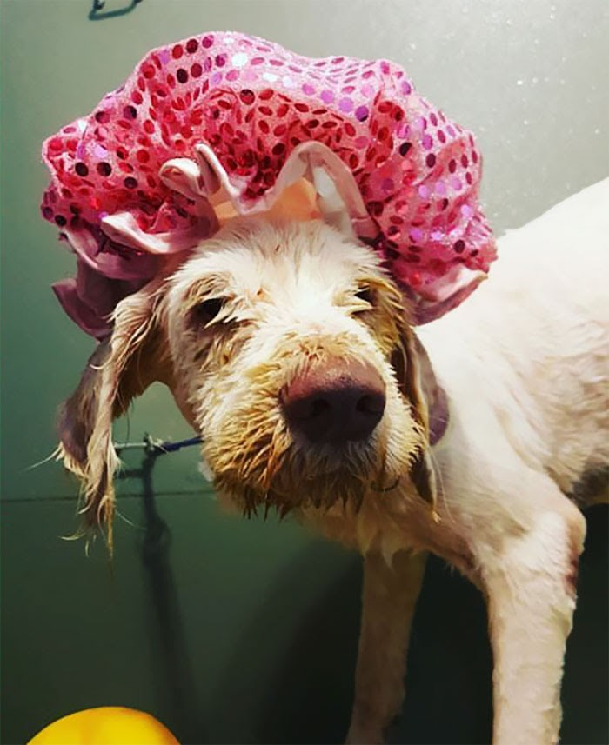
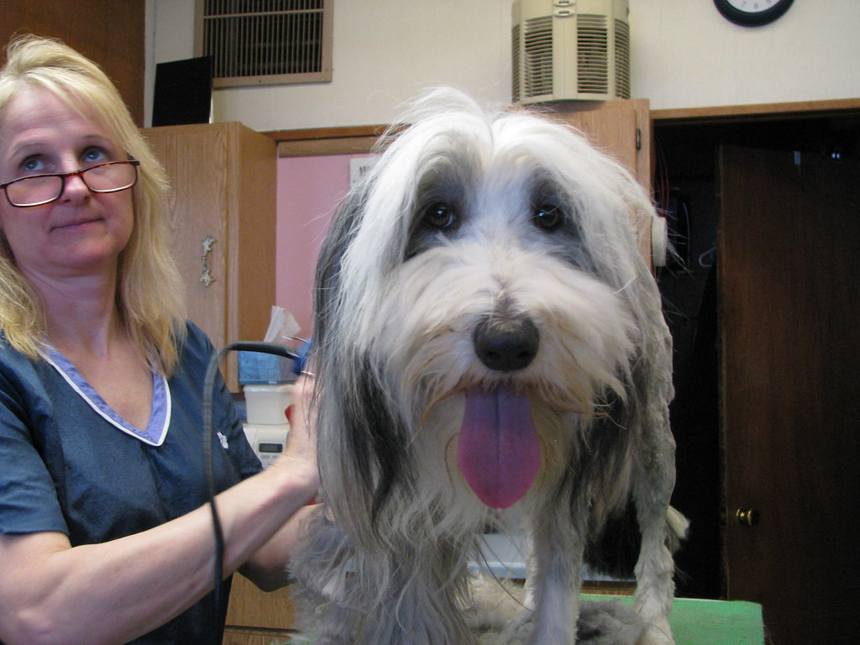
Homepage
A Dog’s Life
A Dog’s Life
Home
Home
Grooming
Map to Store
Contact Us
Selecting a Pet
grooming
Map
Contact
Adopt
“They were so wonderful
with our Brutus!”
-- Sally Anne Cavenaugh, Mesa
Top Ten Dog Tips
Today we are focusing on…
Call Us:
480.123.4567
Text Us:
480.9876.543
Grooming Trends
Pet grooming has come…
Dog food recipe of the week
Resident pet chef Sidney Applebaum
Takes us into his pet approved cuisine
Make an Appointment
Online
Book Now
Tuesday-Saturday
8am-6pm
Service
Grooming
Adoption
Boarding
About ADL
Careers
Newsletter
Contact
Home
Peta
Website Information
Privacy Policy
Subscribe
A Dog’s Life Newletter:
Opt in

Slide 3

Grooming Services
A Dog’s Life
A Dog’s Life
Home
Home
Grooming
Map to Store
Contact Us
Selecting a Pet
grooming
Map
Contact
Adopt
We provide full-service groom in a clean and friendly environment and
You will never blah blah in the end and that is all there is to say.
Grooming Trends
Pet grooming has come…
“Simply the Best!”
-- Penelope Pitstop, Tempe, AZ
Prices & Services
“We had such a great time at ADL”
-- Emmett Fitz-Hume, Phoenix, AZ
Our Products
We use nothing but the
Best groom products
Make an Appointment
Online
“I have never seen
Cujo look so good!”
-- Austin Millbarge, Precott, AZ
Prices and Services
Book Now
Tuesday-Saturday
8am-6pm
Service
Grooming
Adoption
Boarding
About ADL
Careers
Newsletter
Contact
Home
Peta
Website Information
Privacy Policy
Subscribe
A Dog’s Life Newletter:
Opt in

Slide 4
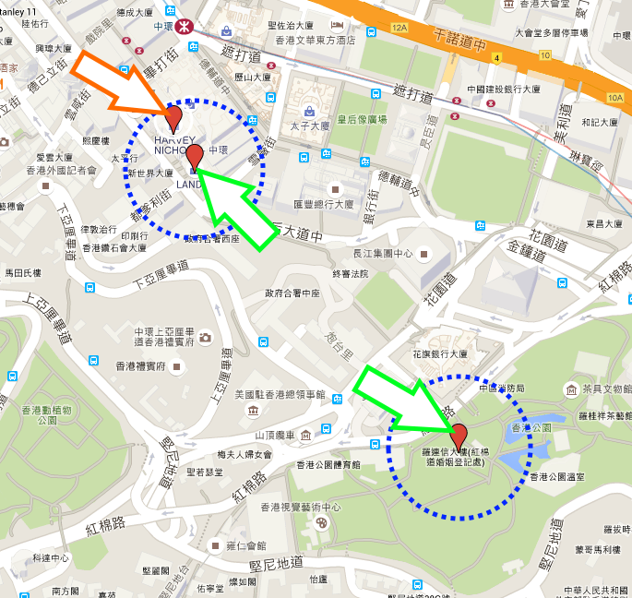

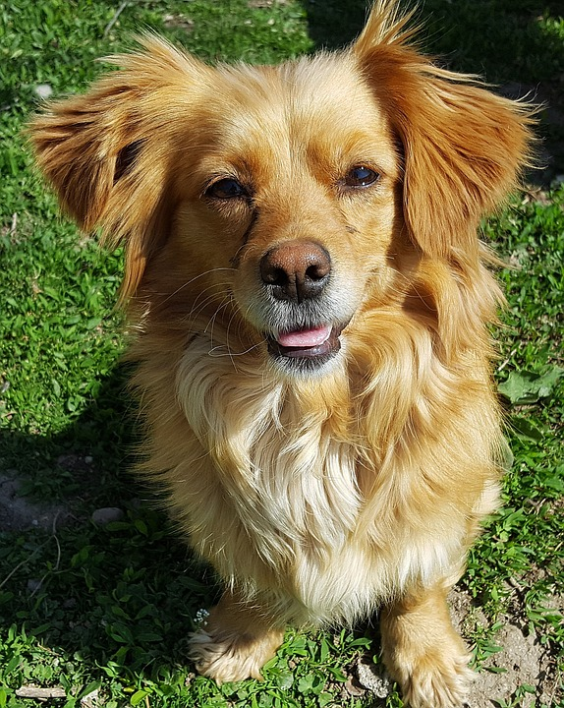

Map
A Dog’s Life
A Dog’s Life
Home
We are located next to Costco on 4th and Dexter. More information as needed blah blah
Home
Grooming
Map to Store
Contact Us
Selecting a Pet
grooming
Map
Contact
Adopt
We are located next to
Costco on 4th and Dexter.
More information
Google Maps
Google maps
Make an Appointment
Online
Book Now
Call Us:
480.123.456
Text Us:
480.987.6543
Tuesday-Saturday
8am-6pm
We Work with all Breeds!
Service
Grooming
Adoption
Boarding
About ADL
Careers
Newsletter
Contact
Home
Peta
Website Information
Privacy Policy
Subscribe
A Dog’s Life Newletter:
Opt in

Slide 5
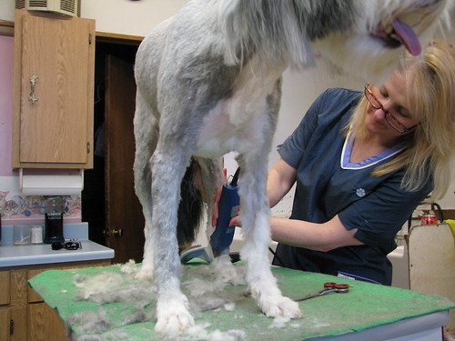
Contact Us
A Dog’s Life
A Dog’s Life
Home
Call Us:
480.123.4567
Text Us:
480.987.6543
Home
Grooming
Map to Store
Contact Us
Selecting a Pet
grooming
Map
Our Family
Contact
Adopt
Make an Appointment
Online
Anna Newberry
Senior Groomer
Lola Falana
Perms and Dyes
Janet Wood
Visionary
Book Now
480.123.4567
Tuesday-Saturday
8am-6pm
Message us at: theadlteam@woof.net
Service
Grooming
Adoption
Boarding
About ADL
Careers
Newsletter
Contact
Home
Peta
Website Information
Privacy Policy
Subscribe
A Dog’s Life Newletter:
Opt in

Slide 6
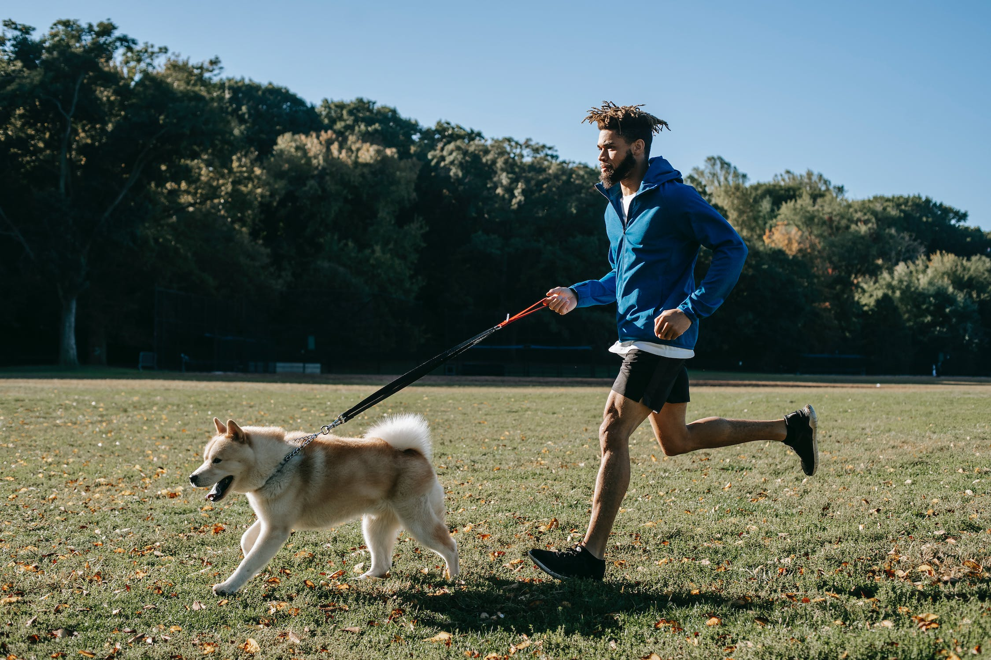
Select a Pet
A Dog’s Life
A Dog’s Life
Home
Selecting your Pet
Try our easy-to-use Pet Matcher we will find the best match for you based on your lifestyle and interests' blah blah you will not regret it!
Home
Grooming
Map to Store
Contact Us
Selecting a Pet
grooming
Map
Contact
Select Pet
Selecting your Pet
Try our easy-to-use Pet Matcher
we will find the best match for you based
on your lifestyle and interests' blah blah
you will not regret it!
Make an Appointment
Online
More Articles on Pet Matching
Petmatcher.com
Findyourmat.net
Adopt a Dog Abroad
Dog Joke of the Day:
“A dog walks into a bar,
He nestles into the first seat
He can find. After some time, the
Bartender sidles over…”
Book Now
Call Us:
480.123.456
Text Us:
480.987.6543
Tuesday-Saturday
8am-6pm
Service
Grooming
Adoption
Boarding
About ADL
Careers
Newsletter
Contact
Home
Peta
Website Information
Privacy Policy
Subscribe
A Dog’s Life Newletter:
Opt in

